Slide 1





Erik Orndahl, Jack Le, Jerome Aragon, Joel Dsouza

Slide 2
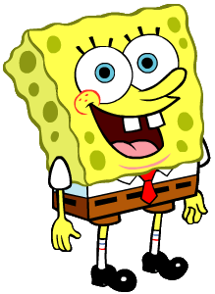

Slide 3


Slide 4
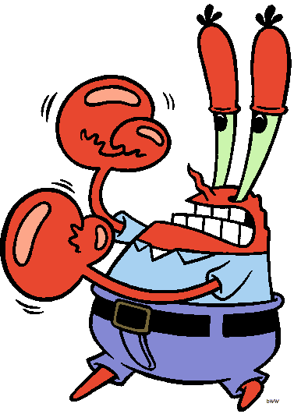

Slide 5
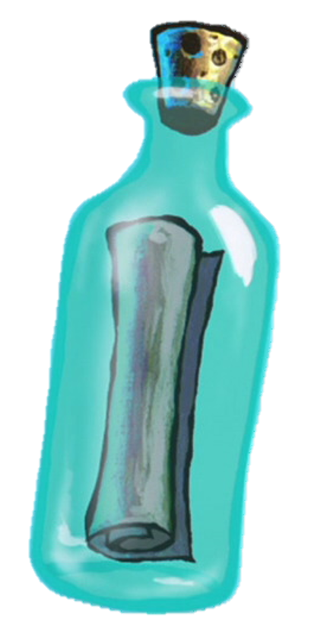

Slide 6
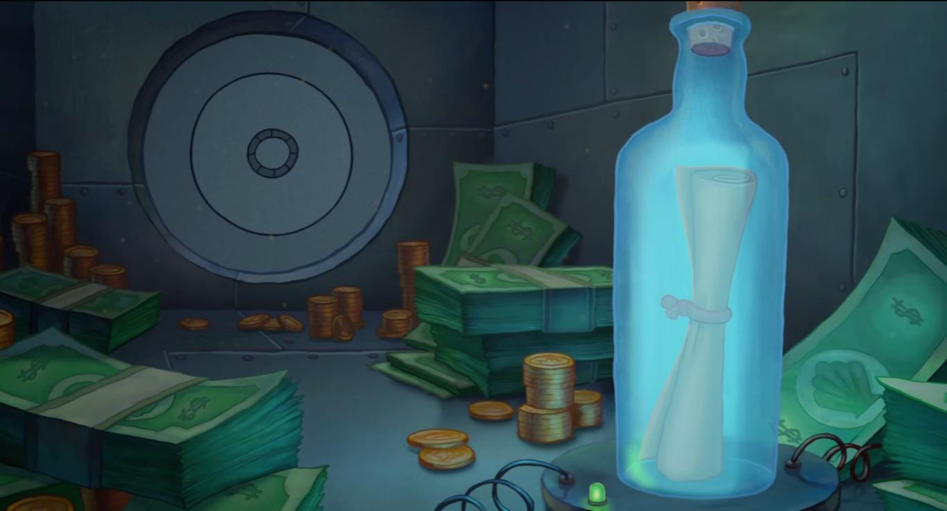

Slide 7
The Idea
Jack: Just the simple game is too bland. We need some theme.
Joel: How about Spongebob?
Everyone: Sure sounds good.
Jack: I’ll handle the animations.
Erik: I’ll do the logic.
Joel & Jerome: We’ll search for materials and help along the way.

Slide 8
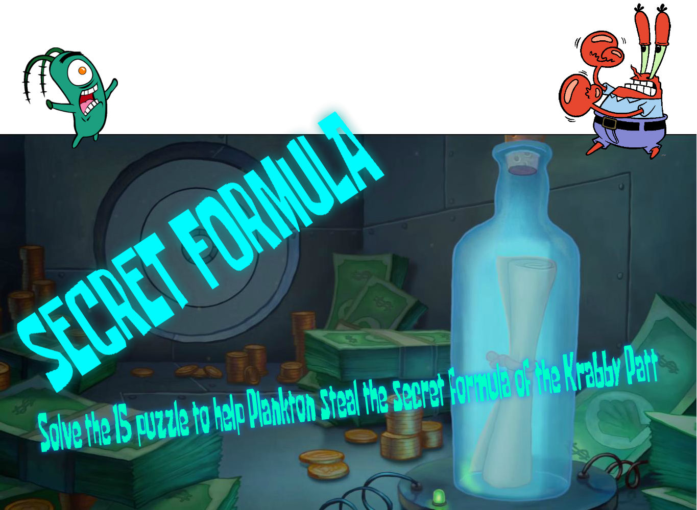
The Game

Slide 9
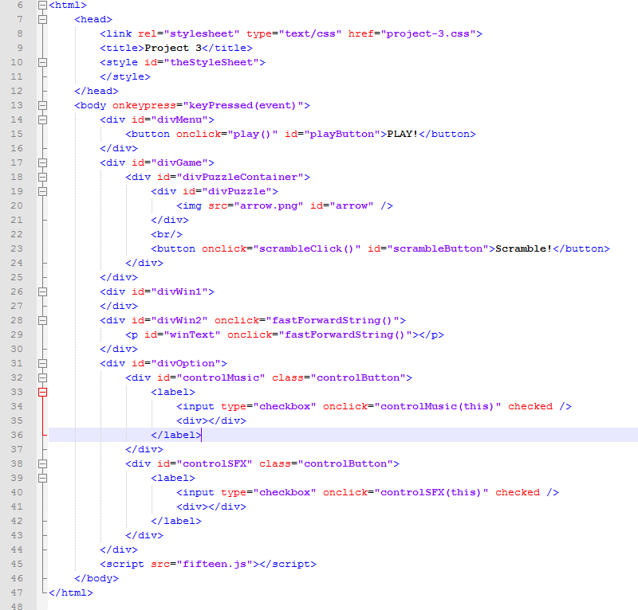
Thanks to JavaScript

Slide 10
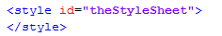
Wait…

Slide 11
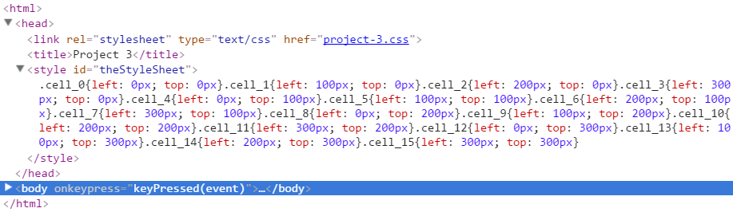
Use Style Sheet as Location Map

Slide 12
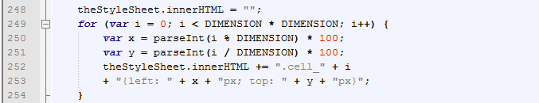
Style Sheet Generating Code

Slide 13
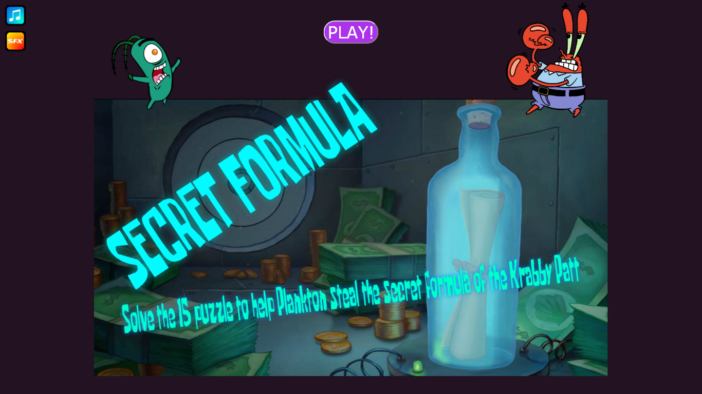
Flow: Menu Screen

Slide 14
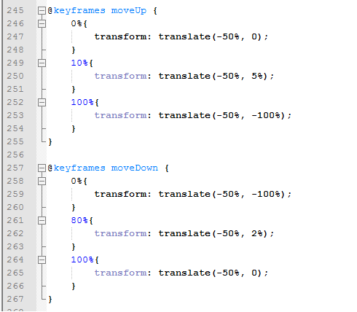
Flow: Screen Transition Animation

Slide 15
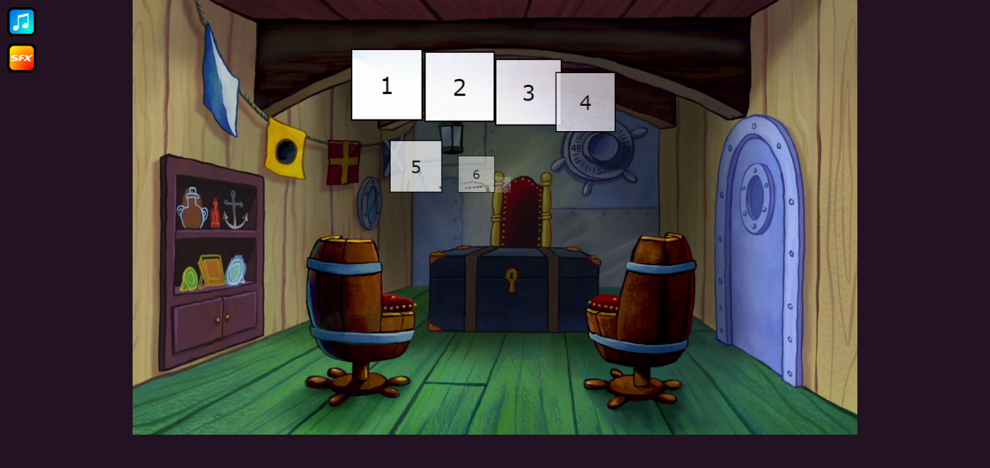
Flow: Game Play Screen – Domino effect

Slide 16
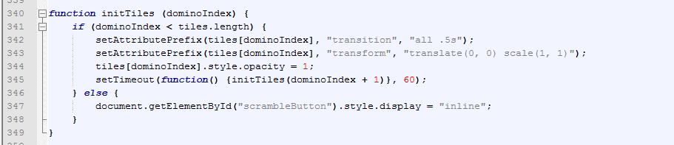
Domino Effect Code – Time-based Recursion

Slide 17
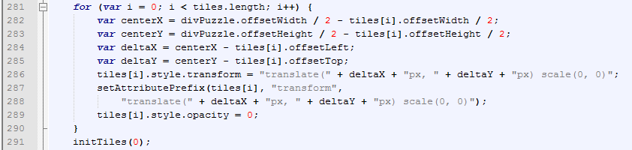
Domino Effect Code – Initial Location

Slide 18
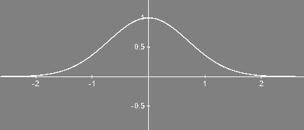
Scramble – Bell Curve Inteval

Slide 19
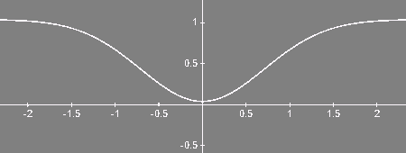
Well…

Slide 20

The Portion We Used

Slide 21
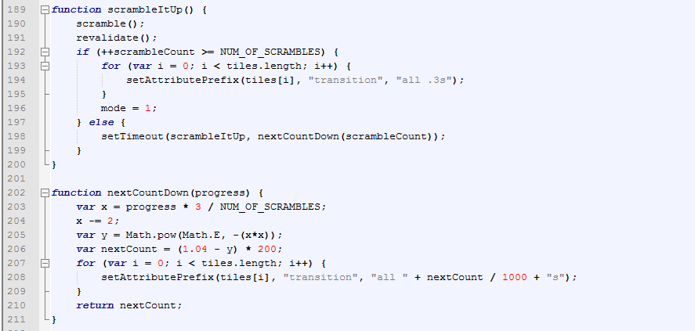
Scramble - Code

Slide 22
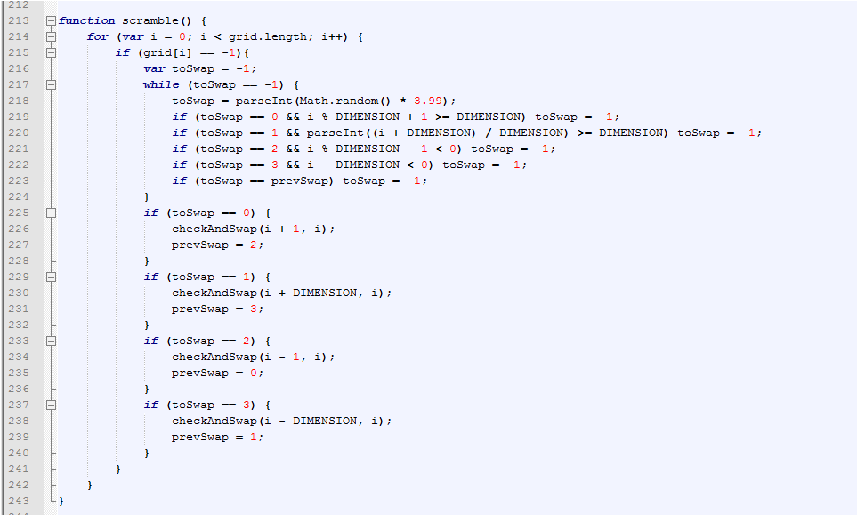
Scramble – Remember The Last Move

Slide 23
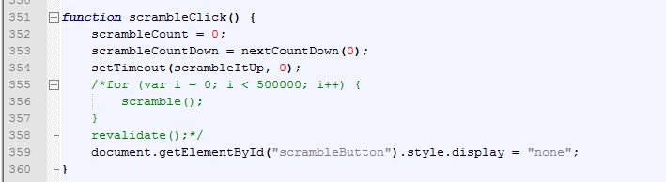
Scramble – Doesn’t Delay Even With 500,000 Swaps

Slide 24
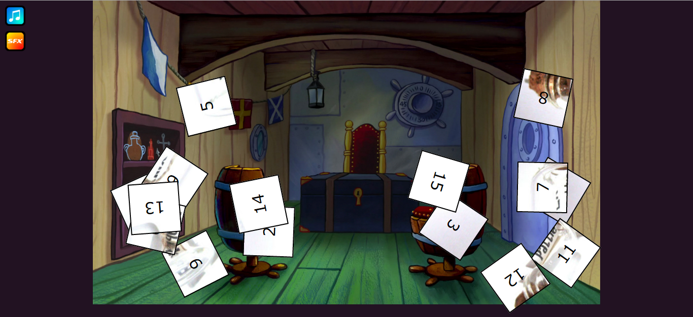
Flow: Winning Animation – Simple Physics

Slide 25
The Phyics
There are 3 main components in movement:
Position.
Velocity.
Acceleration.
Relationship:
Velocity is change of position.
Acceleration is change of velocity.

Slide 26
Velocity Is A Vector

Slide 27
Split It Into Two Components
V_y
V
V_x

Slide 28
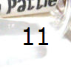
The Components Are Independent
V_y
V_x
A_y

Slide 29
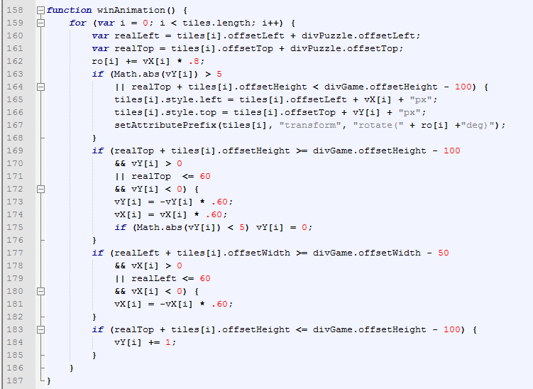
Flow: Winning Animation – The Code (FRESHLY HOMEMADE, NO COPIED AND PASTED)

Slide 30
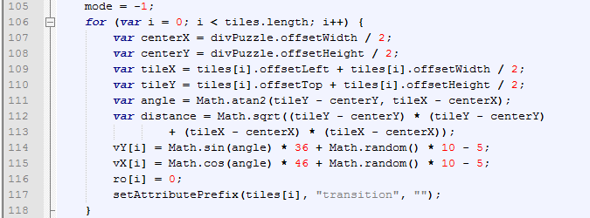
Flow: Winning Animation – Explosion Angles

Slide 31
Flow: Winning Sequence
Puzzle solved.
Pieces explodes, music stops.
First winning screen pops out from center.
First winning screen fades.
Victory screen fades in.
Victory text starts running.

Slide 32
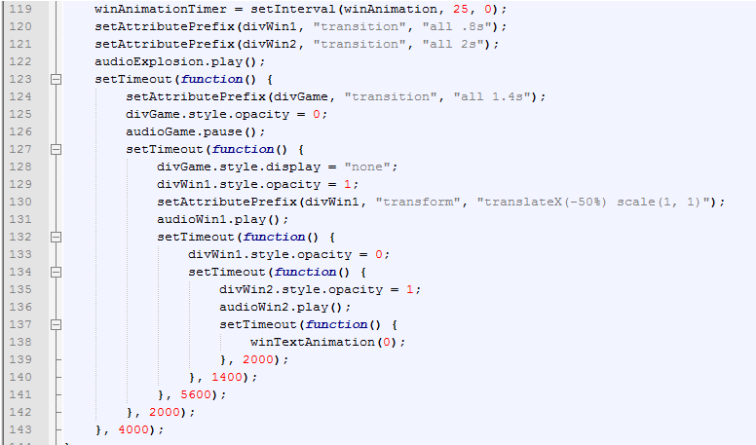
Flow: Winning Sequence - Code

Slide 33
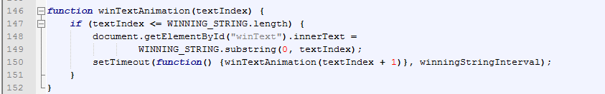
Winning Running Text – Another Recursive Function…

Slide 34
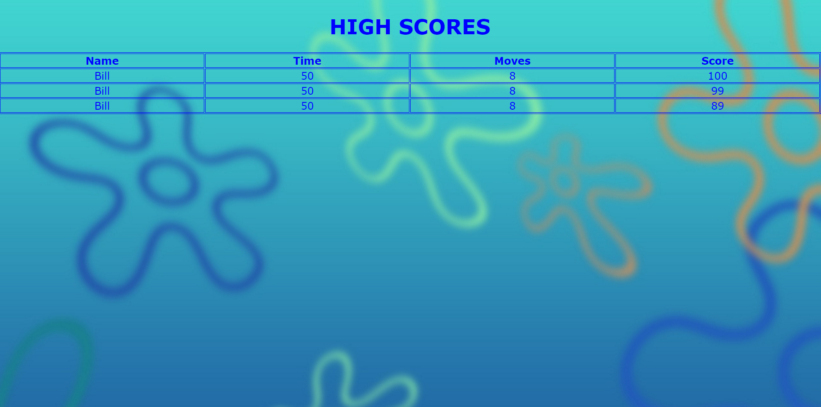

Slide 35
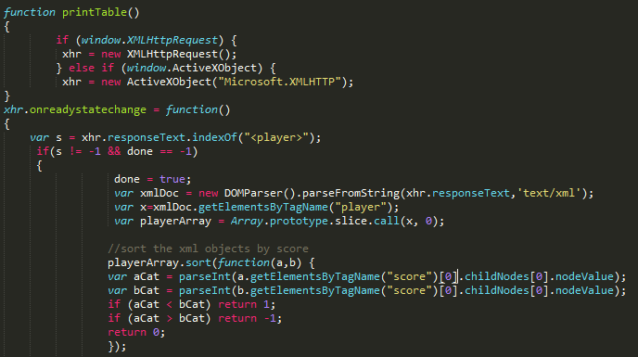
High Score Table Code

Slide 36
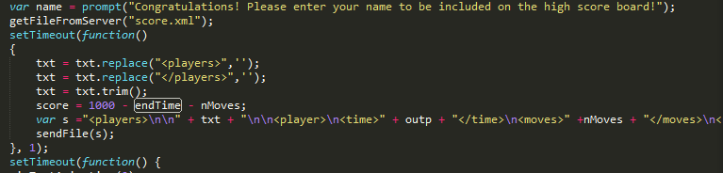
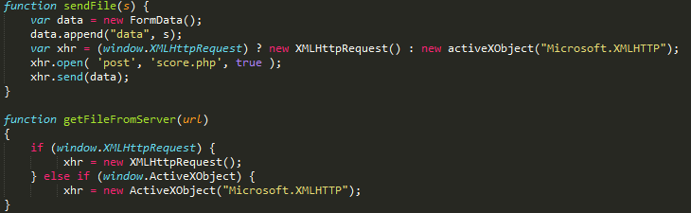
XML Data Save

Slide 37
DEMO

